Slide 1
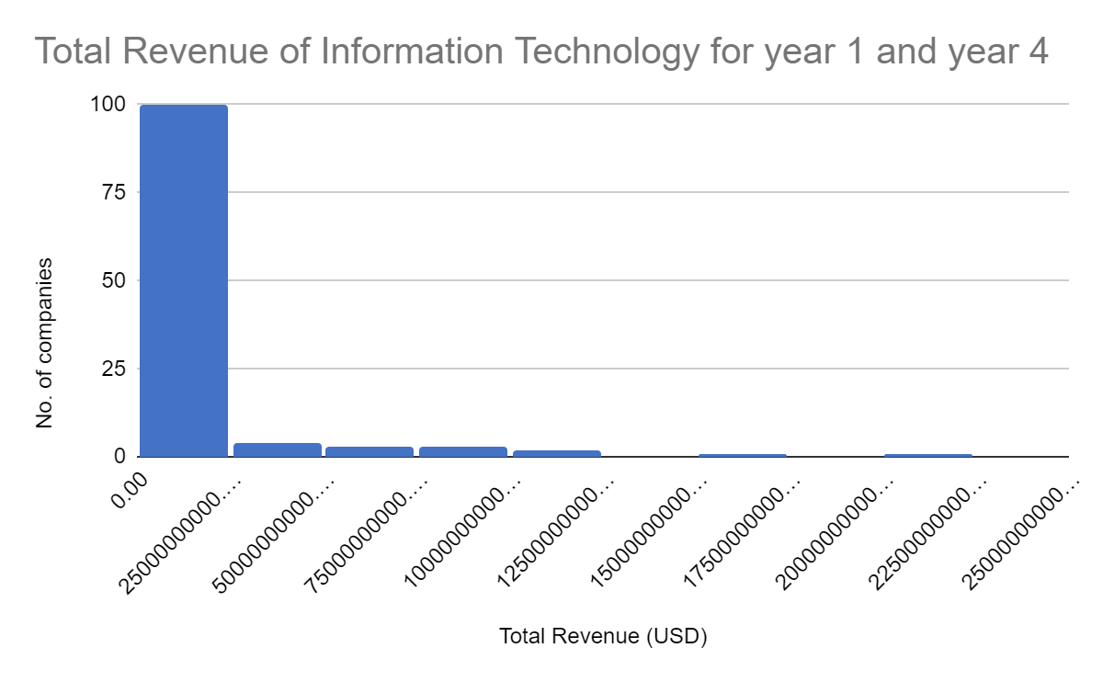
How does the Total revenue for IT industry differ in Year1 and Year4?
The histogram represent Information Technology Total Revenue for Year 1 and Year 4. As the histogram is rightly skewed, it means the mean is greater than median of total revenue. The mean for IT industry Year 1 and Year 4 is $20,721,007,249 and Median is $8,077,927,500 and it shows the mean value is higher and positively skewed and total revenue have increased from year 1 to year 4. The standard deviation of total revenue from calculation is 41638455336 which is a pretty high value and it shows the values are spread out widely from average revenue. The range is $485,649,486,000 which is a much higher range for year 1 and year 4 hence have great variability because the range is spread out.
<visualization or summary statistics used for finding>

Slide 2
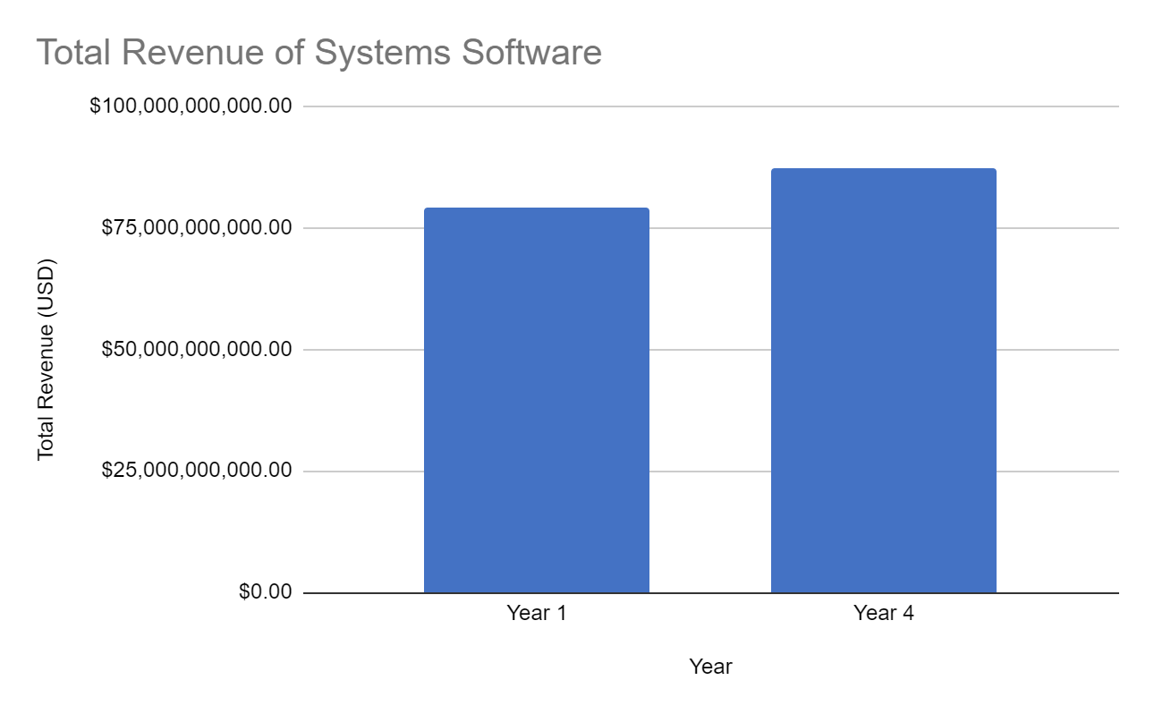
However, if we compare Total Revenue of Systems Software, a sub-category of Information Technology, the total revenue of year 4 is higher than year 1.

Slide 3
Link to Google Sheets
https://docs.google.com/spreadsheets/d/1e9Vkw1e-KHYVECXRXBofMiTuzVjSHciX/edit?usp=sharing&ouid=108139997314301343701&rtpof=true&sd=true

